Slide 1
STEPs4GROWTH—NC Clean Energy Alliance--Members
Advisory Members :
Star Hodge —NCDEQ
Caroline Sullivan– NCBCE
Wanda Ramos-McPherson (App.NC)
Andrea DeSantis– Policy Advisor, Office of Governor
Dr. Jess Englert, Chief Policy Director, Off. Of Governor
Ms. Jennifer Mundt, Asst. Sec. of NC DoC
Technical Team
Balu Gokaraju, (NCAT & CERT))
Greg Monty (Director of CERT & NCAT)
Ray Tesiero (NCAT & CERT)
Steve Kalland— CTC, NCSU
Allison Carr– CTC, NCSU
Rhonda High—HCC
Center for Energy and Research Technology (CERT)
NC Business Council for Education (NCBCE)
NC Department of Environmental Quality (NCDEQ)
Office of Governor
Halifax Community College (HCC)
ApprenticeshipNC (App.NC)
Clean Tech Center (CTC), NCSU
NC A&T State University (NCAT)

Slide 2
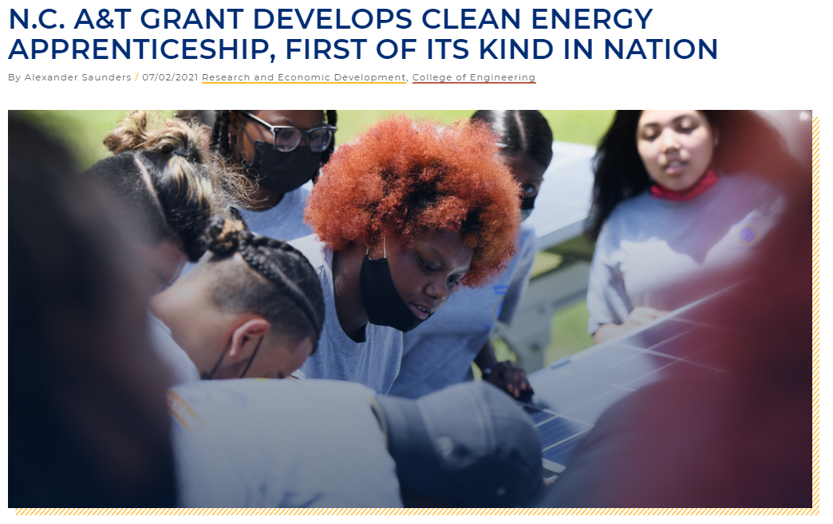
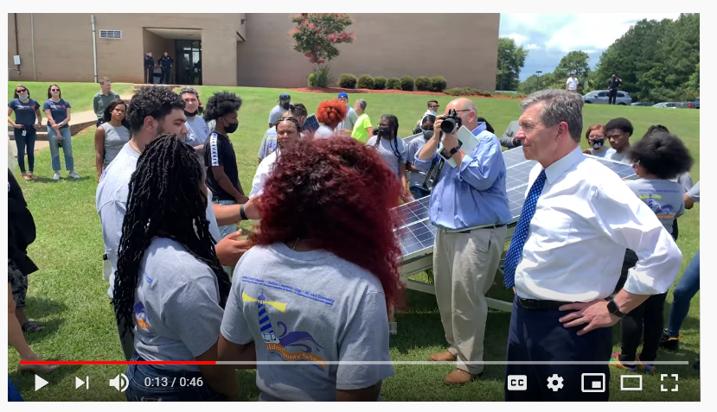
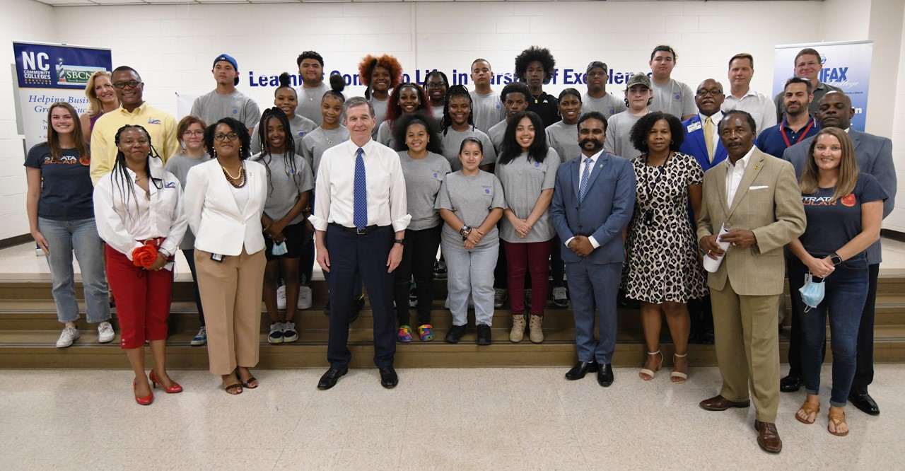
NCDEQ Funding : 165K ; Gov. Cooper July 1 2021

Slide 3
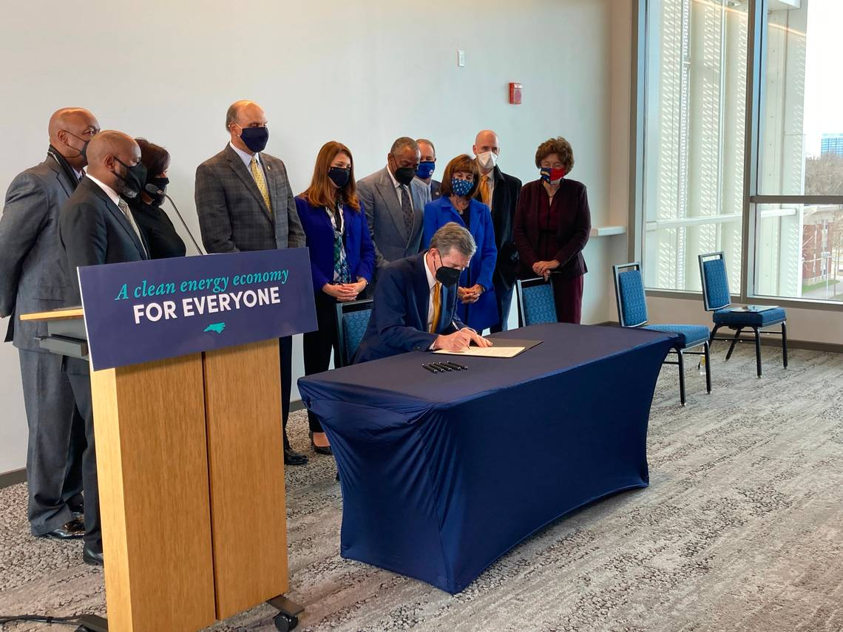
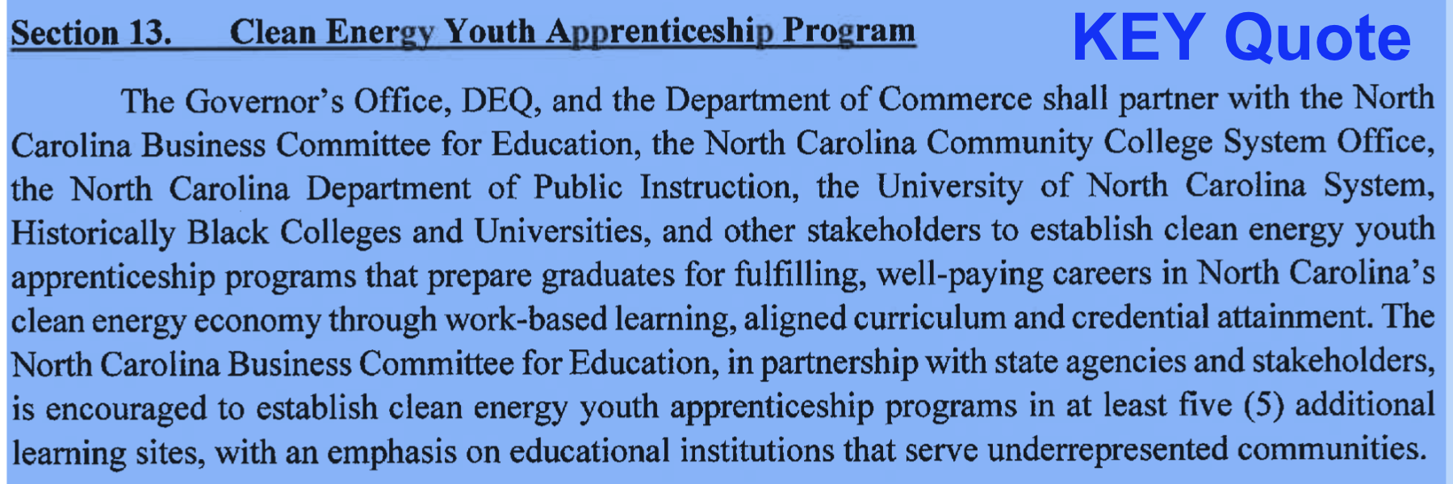
Executive Order No. 246 signed at NC A&T, on Jan 7th 2022 Governor Cooper showed support for this grant-GJC
NCDEQ Funding : 165K /1.05 M; Gov. Cooper Jan 7 2022
Notes:
Change to 12 noon our weekly meetings.

Slide 4
Proposals using Gov. Cooper’s Support Letters
500k Build Back Better Phase-1 Proposal, Oct. 15 2021
$25 Million to EDA-Good Jobs Challenge, Feb 10 2022
$6 Million invited by Hilary Sherman to apply for EDA- CoP, March 18 2022
$10 Million to DOL-ABA April 25 2022
$110 million to NCDEQ Oct. 1st 2022: Building Apprenticeship Model
$500 million to DoE Nov 2022: Apprenticeship Model for Energy

Slide 5
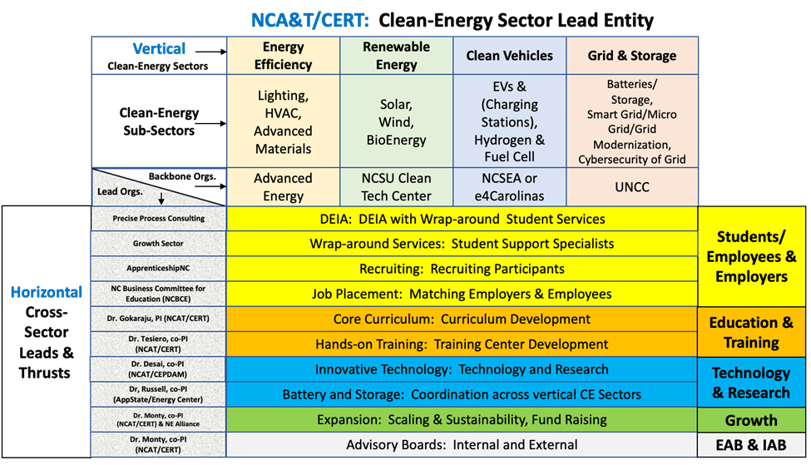
Sector-Strategy Framework for STEPs4GROWTH
Notes:
Associates in Engineering. GTCC will follow Statics; applied engineering;

Slide 6
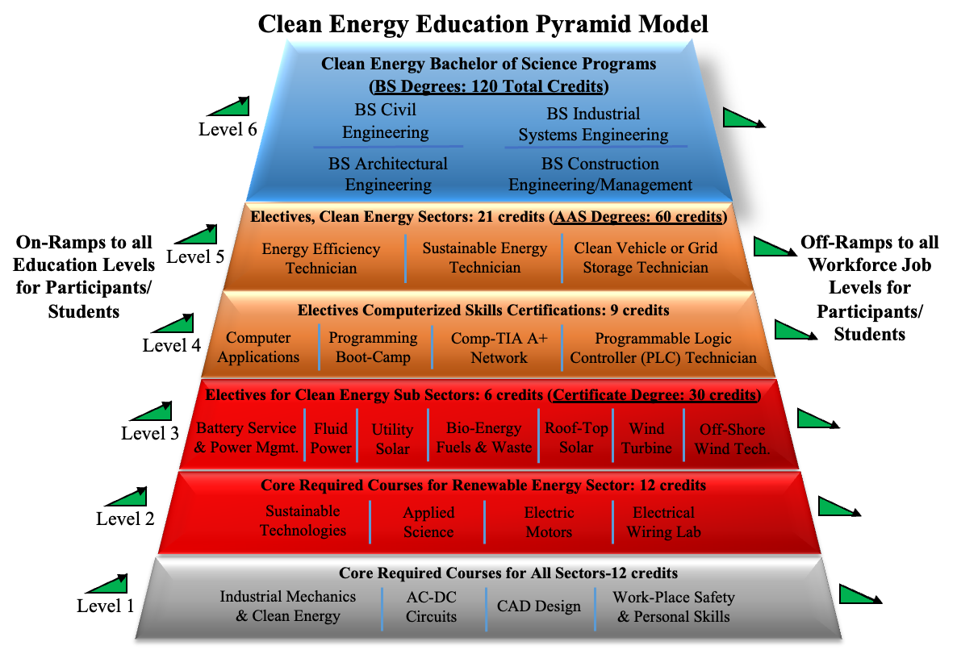
Education Pyramid Model for Renewable Energy

Slide 7
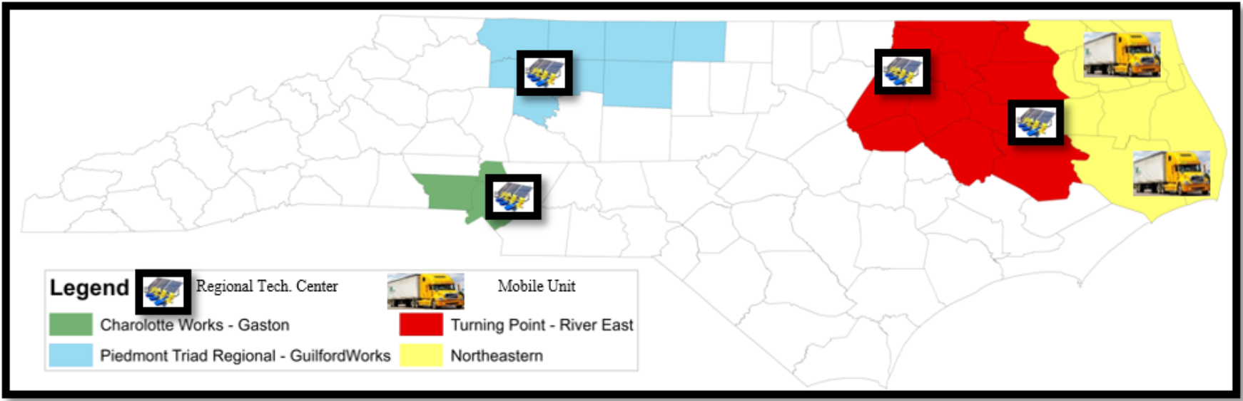
Clean Energy Regional Technology Centers
Notes:
Steve Kalland already have one mobile unit. Already using for 8 years ( 1 existing, 6 year older). Flat bed, small roof with arrays, roof is modular. Davidson comm. College has machining mobile unit. Opportunities to upgrade from our GJC grant.
PTRC also have a mobile trailer. Fees paid by Community college (training service agreement). Spring break training in CS. Custom training for industries.

Slide 8
Plan for the Aug 3rd: EDA-NC A&T & Gov. Office Suggestion
Walk and Talk, 10:55am:-- By Chancellor Dr. Martin, Gov. Cooper, Rep. Manning-Recording, and Dean LT, to Robotics and EV Lab---15 mins
Student-1 Walk & Talk : Ms. High, High School rural Nash county student.
Student-2 DEMO & Talk: Victor Oyadongha at Robotics Lab, 5 minute, NCAT
Student-3 DEMO & Talk : Sydney Parker at EV Lab, NCAT (Podium Event)
Podium Event at 11:15 am -12 noon :-- Hon’ble Sec. Raimondo + Dr. Martin, Federal invited Guests. Sec. Sanders will be at the announcement.
Round Table/VIP Room-11:55am-12:45 pm :-- Hon’ble Sec. Raimondo+ Gov. Cooper+ Dr. Martin--45 Mins.
10 industry CEOs/Vice Presidents : (EDA invitations)
NCSEA, Duke, Siemens, STRATA, VinFast, Toyota, Boom Supersonic, Piedmont Services Group, NC EMC, AEG, IBEW
1 Adult Participant, Bryan Letren—AA Male ( Guilford Tech. Student)
1 Hispanic male Student, job placement with local EE-HVAC employer.
Mask Optional—Governor’s office suggestion?

Slide 9
General Statement :
There are 113,000 jobs in Clean Energy in North Carolina and NC State is Ranked #1 in the placements of rural Jobs of Clean Energy (Ref. E2 report 2021).
There is a huge need for hi-tech skills training programs in Clean Energy that will lead to high paying Good Jobs for America.
STEPs4GRWOTH project is the largest comprehensive workforce development solution for NC, rural America and can become a model for the nation.
Students and incumbent workers are going to receive this training, and the employers will benefit from the workforce and Sector Strategy Partnerships.
STEPs4GROWTH aim 3000 Good Job placements with High tech skills & High paying Good Jobs.

Slide 10
Hon’ble Governor Cooper & Hon’ble NC-DOC Secretary Sanders got invitations by Federal DOC and are planning to come to the event certainly and stay for 2 hours.
Greet the team by Provost SJ or Dean LT (A&T researchers, NCDEQ, NCSU, UNCC, Office of Governor, 16 community colleges, 3-largest energy membership organizations—NCSEA, AE and e4Carolinas, 3 state energy centers, 100 industries) that worked for a year to design the NC Clean Energy Sectoral Strategy Partnership framework, toward a largest comprehensive workforce development system.
I feel the whole country is watching us now due to following facts:
Largest Grant of 23.7M awarded to the only Clean Energy Project out of 509 applications to GJC, in a pot of $500 Million and average ask is $12.5 Million of all applications.
We believe and many of our partners agree that this framework has potential to be successful and become a national-model. We will show that the HBCU can lead it for the country.
Our stakeholders believe that the A&T is gonna be a CORE CLEAN ENERGY WORK FORCE DEV. Center for the whole nation (followed by research money), and it is very proud moment that the largest HBCU College is leading this time. Federal EDA confirmed today that Clean Energy is the hot topic now and they want to support this technology and north Carolina Gov. Cooper’s EV vision.
Many Collaborators have been reaching out to us for past two months that we could be very successful with the Good Jobs Challenge Award and inviting us to be part of large ERCs, DOL, and DoD proposals at the order of 10 million dollars.
In Yesterdays’ call, DOE Director is planning to meet us soon after hearing about our project through a collaborator from UNCC. They mentioned that they are struggling to design a large scale apprenticeship model with $500 Million allocated budget in less than 3 months. These are IIJA funds.
With very good intentions, I would like Hon’ble Sec. Raimondo, Hon’ble Gov. Cooper, Chancellor Dr. Martin to take the opportunity and brag above facts during the announcement and in front of the large press.
This would help me to do my job little easier for next 4 years when we could outreach great in public media.

